Slide 1
Speech Emotion Recognition
Presented by:
Kishan Lakhatariya (C0849341)
Harshkumar Patel (C0848343)
Mohammaddin Masbi (C0850500)
Kanan Trivedi (C0851492)
Professor: Dr. Parisa Naraei

Slide 2

Content
Library
Dataset
Dataset Processing
Exploratory Data Analysis (EDA)
Audio Pre-processing
Feature Extraction and Selection
Model Training and Evaluating
Results
Conclusion
Introduction
Purpose
Notes:
When conducting research, it is easy to go to one source: Wikipedia. However, you need to include a variety of sources in your research. Consider the following sources:
Who can I interview to get more information on the topic?
Is the topic current and will it be relevant to my audience?
What articles, blogs, and magazines may have something related to my topic?
Is there a YouTube video on the topic? If so, what is it about?
What images can I find related to the topic?

Slide 3
Introduction
Emotion plays a significant role in daily interpersonal human interactions. Speech Emotion Recognition is the act of attempting to recognize human emotion and affective states from speech. This capitalizes on the fact that voice often reflects underlying feelings through tone and pitch. The idea behind creating this project is to build a machine learning model that could detect emotions from the human voice. It will analyze different emotions like
Calm
Happy
Fearful
Disgust
Sad
Angry

Slide 4
Purpose
The purpose of building this project is to make the online health care sector more advance by interpreting the voice of the patient in voice-over meetings.
The second purpose of the model is used in chatbots and personal AI assistance to recognize emotion and react or reply based on the user’s feelings.
The third use case is in a call center, the conversation may be used to analyze the behavioral study of call attendants with the customers, which helps to improve the quality of service.
We can also use this model in advanced robotics to understand Emotions.

Slide 5
Dataset
In the model training, we have used two different datasets, which are,
The RAVDESS (Reyorson Audio-Visual Database of Emotional Speech and Songs) dataset. It consists voices of 24 professional actors. 12 are male voices, and 12 are female voices vocalizing two lexically matched statements in a neutral North American accent. The total size of this dataset is 24.8 GB. It contains in total 1440 audio samples with 8 different emotions.
The TESS (Toronto emotional speech set) dataset, A set of 200 target words, was spoken by two actors and actresses aged 26 and 64 years with seven emotions (anger, disgust, fear, happiness, pleasant surprise, sadness, and neutral). There are 2800 stimuli in total.

Slide 6
Libraries
We have used the Pandas library for handling the dataset.
For audio handling, pre-processing and feature extraction, we have used Librosa, Pydub, and Pyaudio libraries.
For feature scaling and label encoding, we have used the Sklearn library.
To visualize the data, we have used python libraries called matplotlib and seaborn.
For model training and evaluation, we have used TensorFlow and Keras.
Notes:
Once you find your sources, you will want to evaluate your sources using the following questions:
Author:
Who is the author?
Why should I believe what he or she has to say on the topic?
Is the author seen as an expert on the topic? How do you know?
Current:
How current is the information in the source?
When was the source published?
Is the information out-of-date?
Accuracy:
Is the content accurate?
Is the information presented objectively? Do they share the pros and cons?

Slide 7
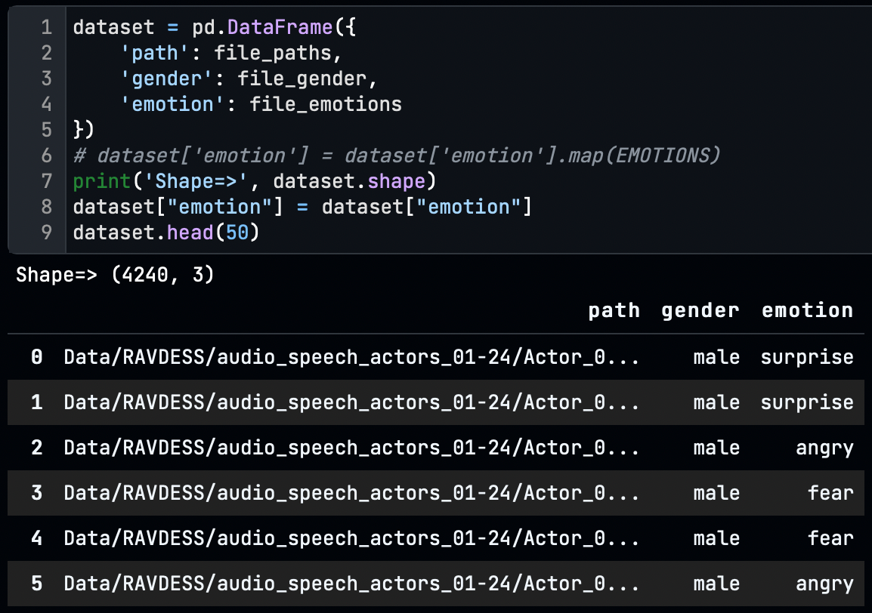
Dataset Processing
Combine the two datasets into Pandas Data Frame
Extracted the emotions and gender using the name of the file.
RAVDESS audio has a filename with 03-01-06-01-02-01-12.wav
From this, all part of the name, the third and last number identifies the Emotion and gender as,
Emotion (01 = neutral, 02 = calm, 03 = happy, 04 = sad, 05 = angry, 06 = fearful, 07 = disgust, 08 = surprised)
Actor (01 to 24. Odd numbered actors are male, even-numbered actors are female).
TESS filename is OAF/YAF_actorename_emotion.wav
OAF = Male
YAF = Female

Slide 8
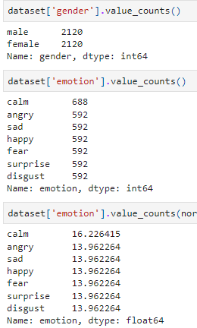
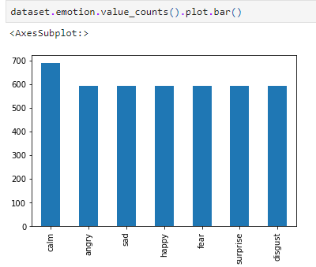
Exploratory Data Analysis (EDA)

Slide 9
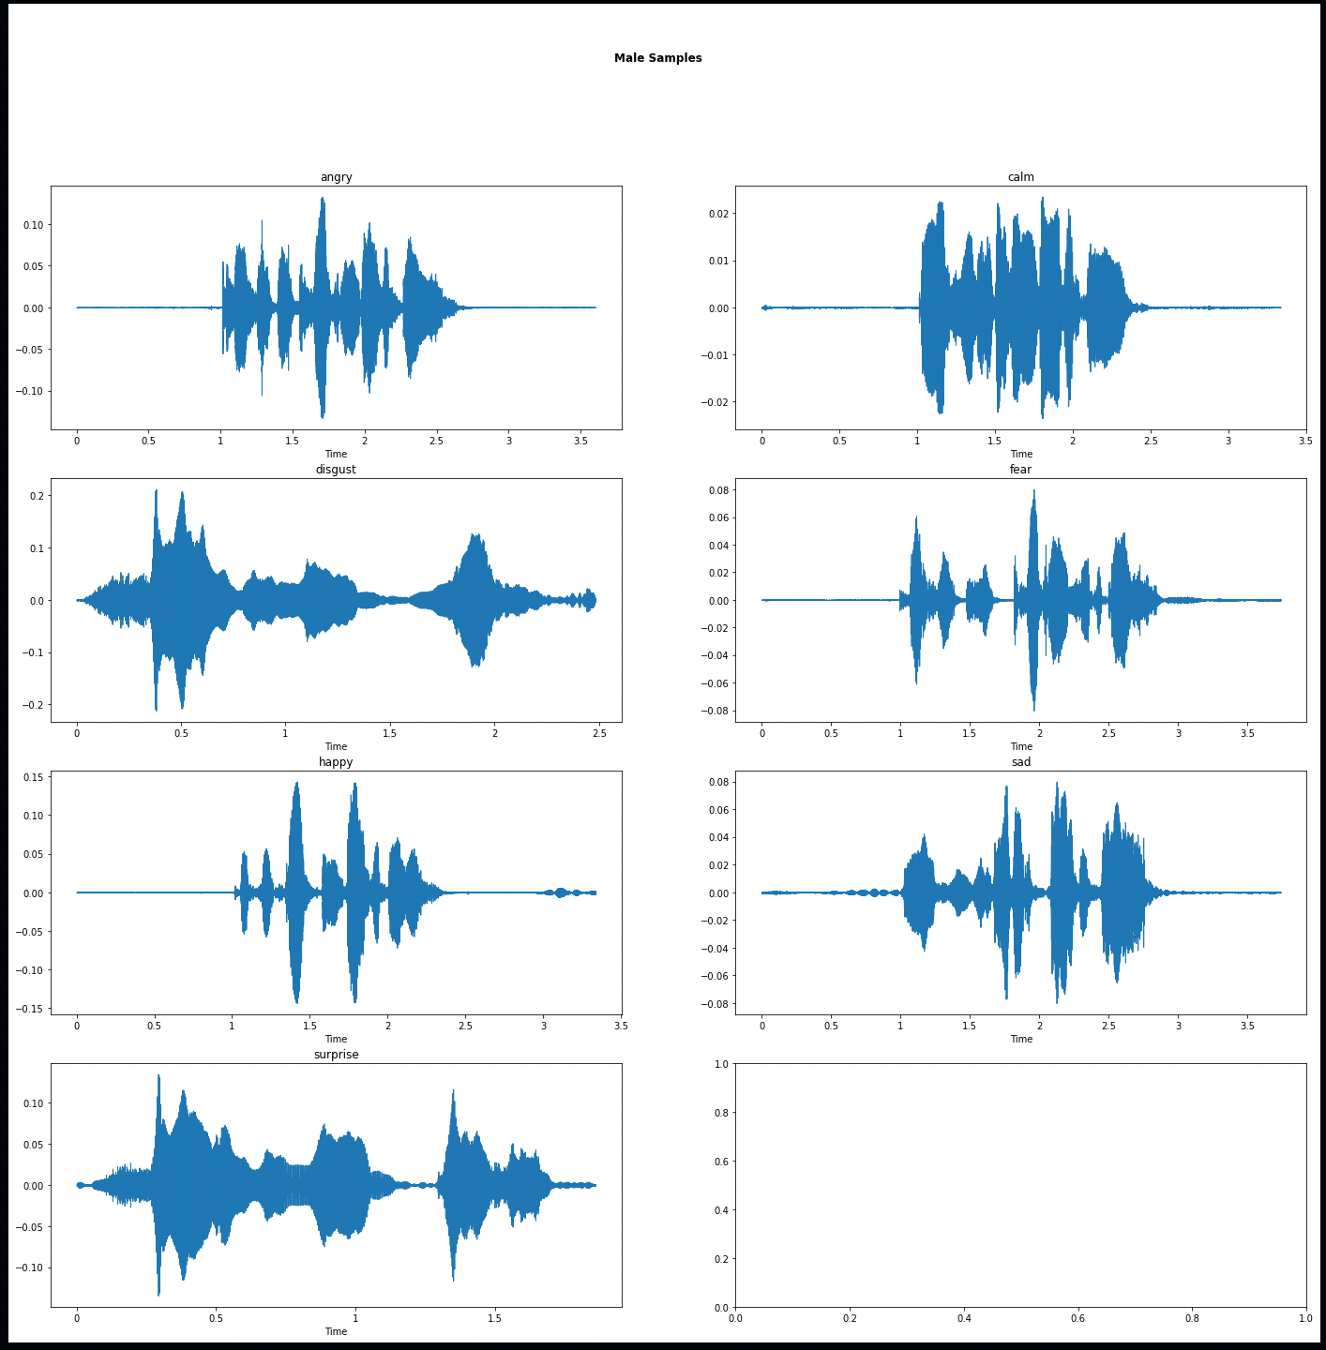
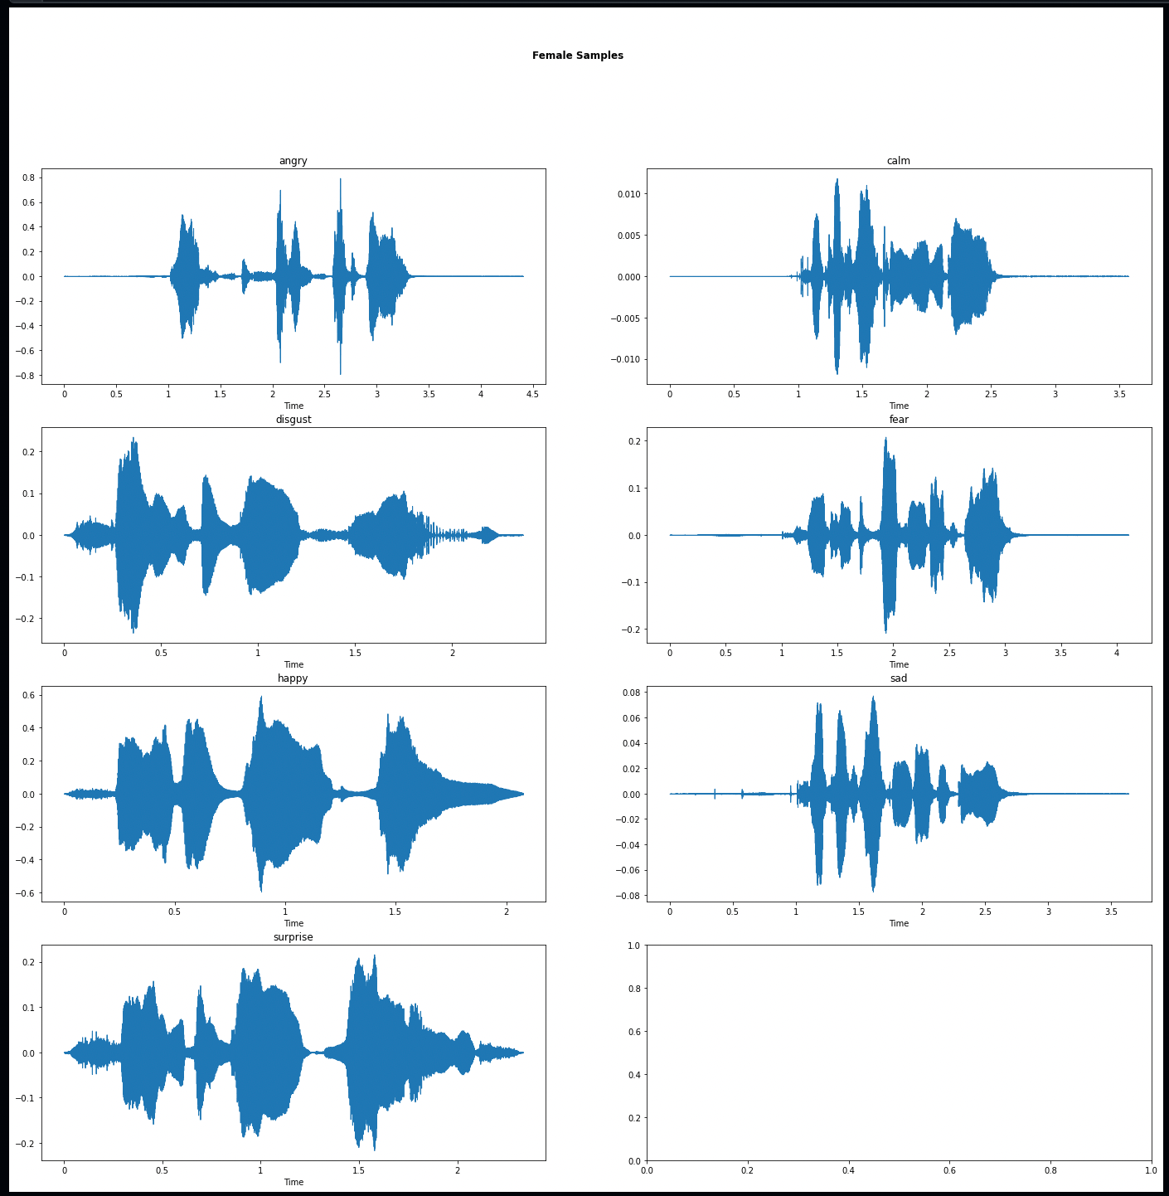
Here, we can see that all emotion has its own shape in the form of energy and frequency with gender as female has a high pitch.

Slide 10
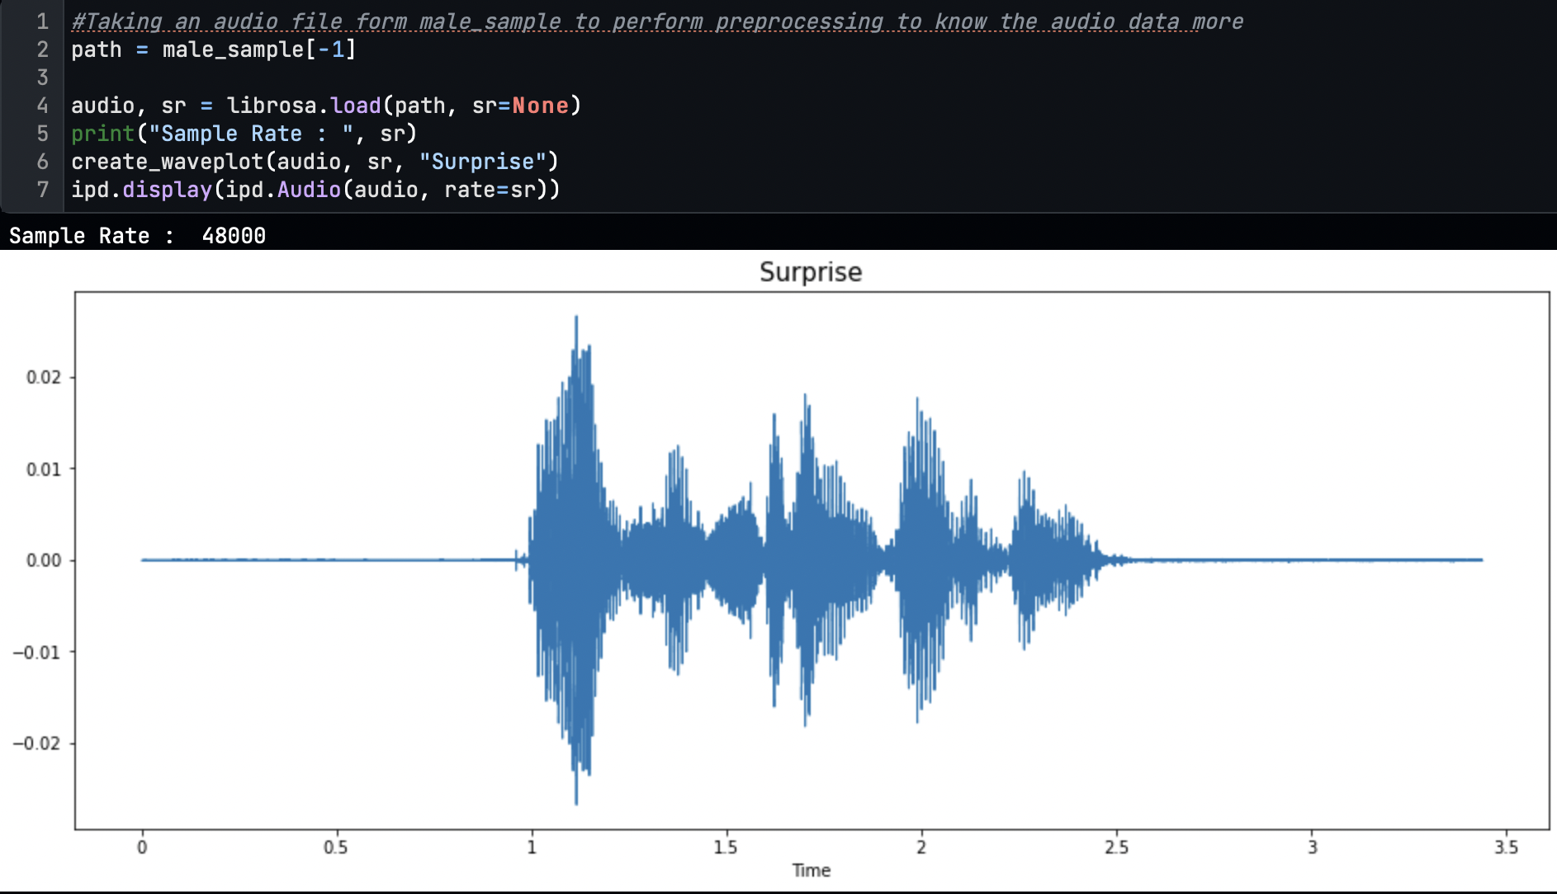
Pre-Processing
We have processed a single file for the initial pre-processing steps.
Loading audio signal and displaying
Notes:
Now, that you have narrowed your topic, you will want to organize your research in a structure that works. There are some common organizational patterns based on the kind of research you are doing.
Organizational Structures:
Cause and Effect- this kind of structure is great for explaining the causes and effects of a topic
Compare and Contrast- in this pattern you highlight the similarities and differences of the topic
Explain process- this structure is great for outlining a series of steps to follow;
Definition- if you want to make sure your audience understands what something is using illustrations, meanings, clarifying misconceptions, you may want to use this structure
Classification- a common organizational structure is grouping like topics or facts from the research together. For instance, in the internet safety about social media apps, you may organize the research where you look at each social media app one at a time

Slide 11
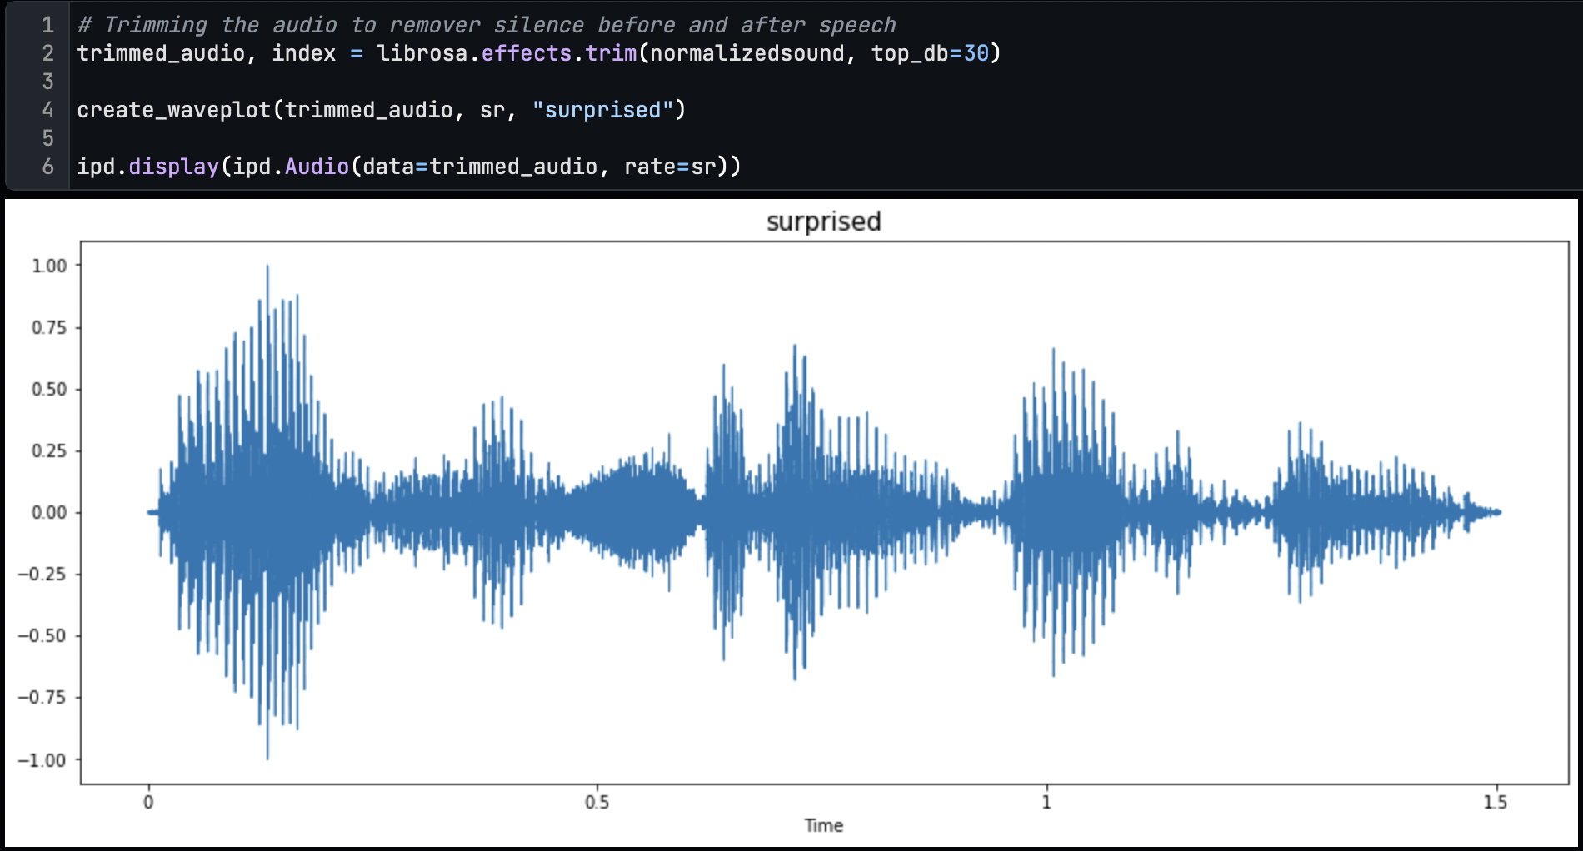
Trimming the silence part

Slide 12
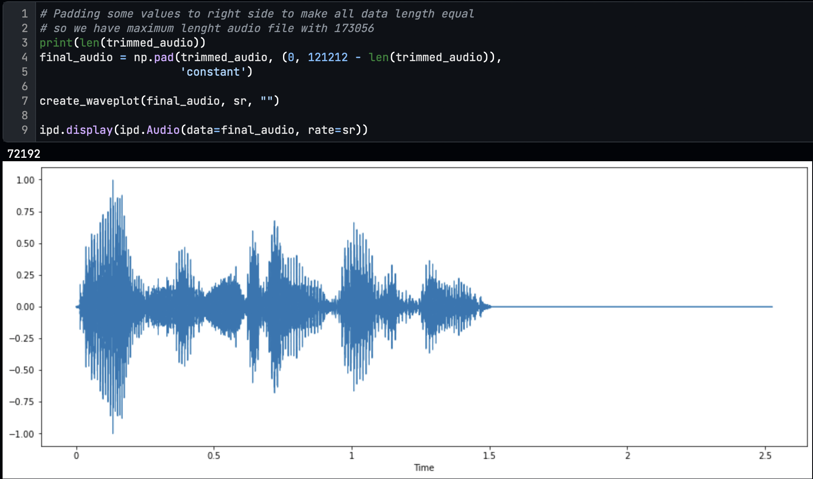
Equalizing Audio Length

Slide 13
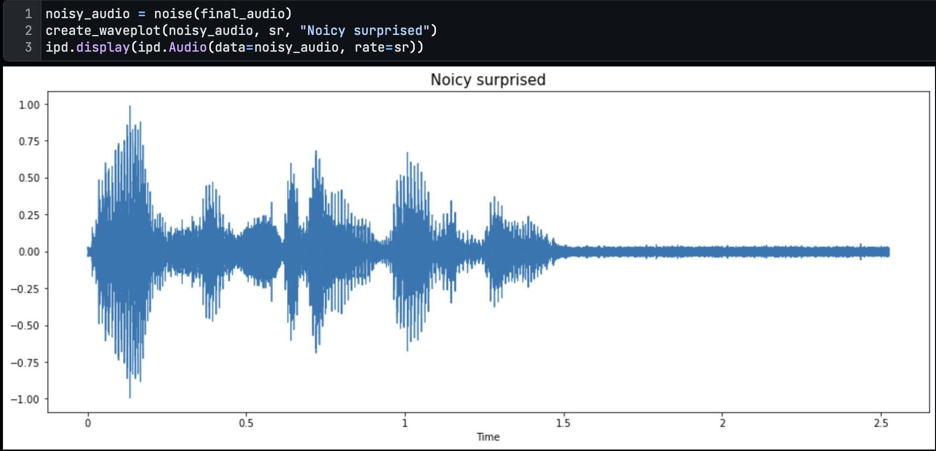
Adding Noise
We observed that the dataset is too low to fit the model. Also, to make emotion recognition possible in noisy audio, we doubled up the dataset by adding the noise to every file during preprocessing.
So, before adding noise, we have 4240 audio samples, and after adding noise, we have a total sample of audio is 8480.

Slide 14
Feature Extraction and Selection
We have extracted and selected these three features from the audio signal.
Root Mean Square Energy (RMSE)
Mel-Frequency Cepstrum Coefficients (MFCC)
Mel Spectrogram

Slide 15
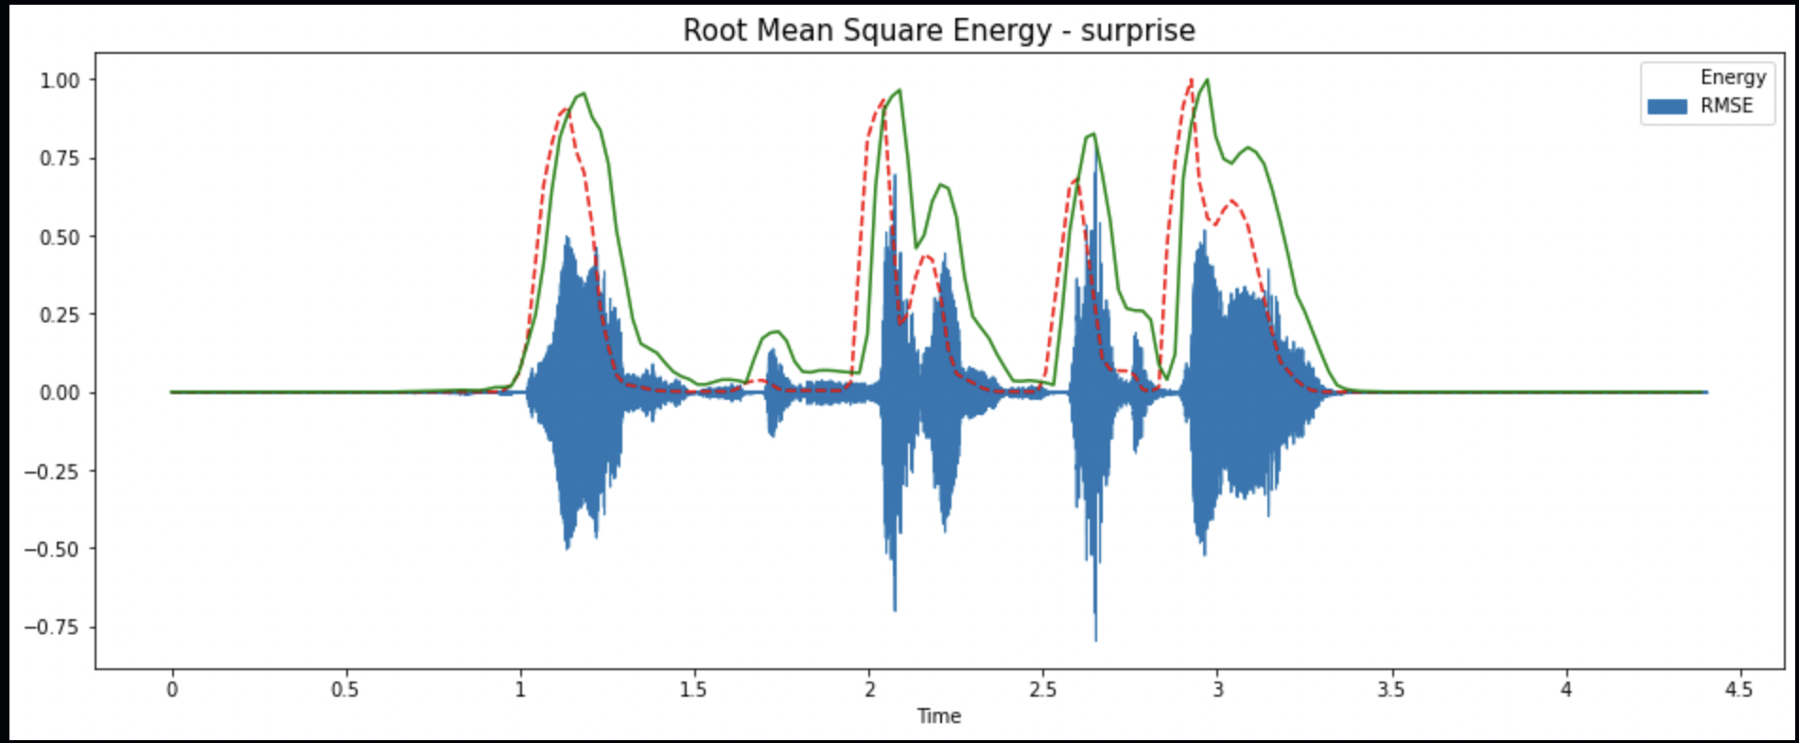
Root Mean Square Energy (RMSE)
The overall magnitude of a signal corresponds to its energy. For audio signals, this generally equates to how loud the signal is.

Slide 16
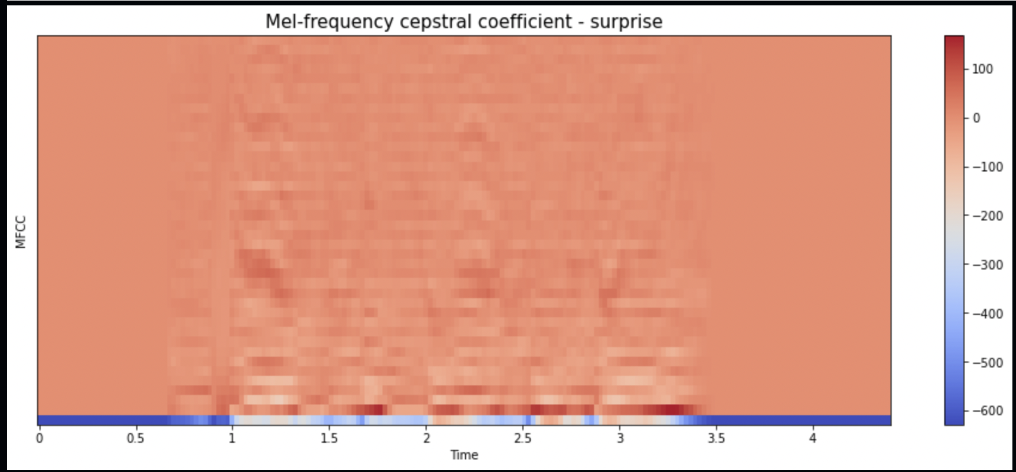
Mel-frequency cepstral coefficients (MFCCs)
The Mel-frequency cepstral coefficients (MFCCs) are a representation of the short-term power spectrum of a sound based on a linear cosine transform of a log power spectrum on a nonlinear Mel scale of frequency. Mel-frequency cepstral coefficients (MFCCs) are coefficients that collectively make up an MFC.

Slide 17
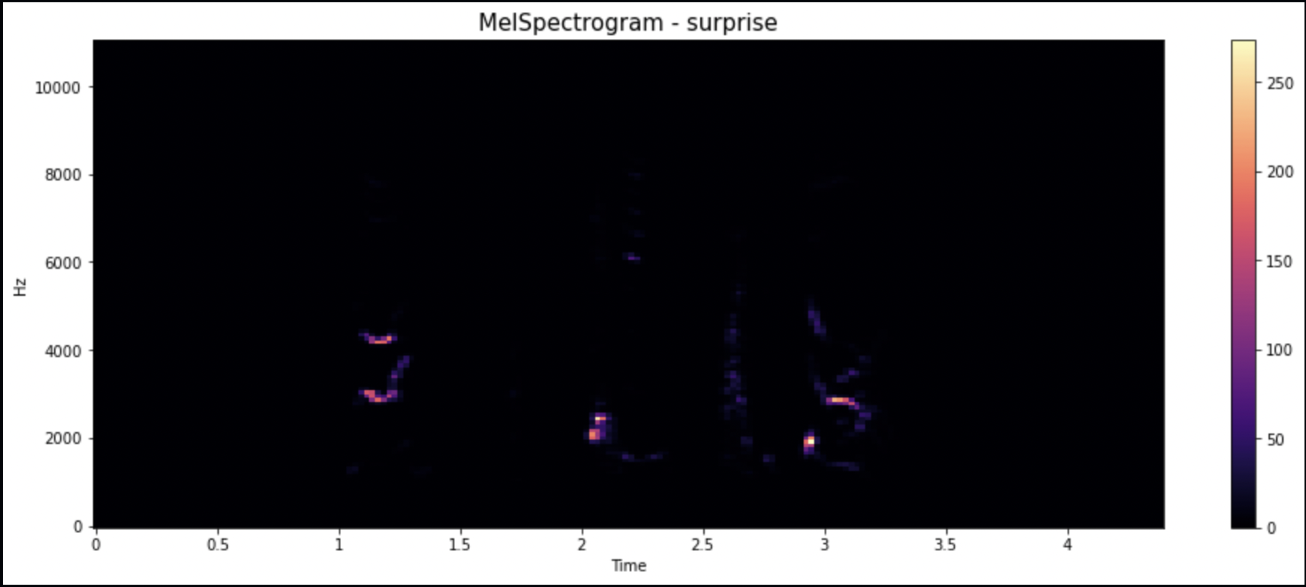
Mel Spectrogram
The Mel Spectrogram remaps the values in hertz to the Mel scale as we are better at detecting differences in lower frequencies than in higher frequencies. For example, we can easily tell the difference between 500 and 1000 Hz, but we will hardly be able to tell the difference between 10,000 and 10,500 Hz, even though the distance between the two pairs is the same.

Slide 18
Scaling and Labelling
From this, all pre-processing and feature extraction was performed on one file; we created two functions for pre-processing and feature extraction to perform this step on all files.
After extracting all features, we scaled the feature with the Standard Scaler of the Sklearn library and converted it into a NumPy array.
We encoded all 7 labels with One Hot Encoding.
Now, we have everything to train the LSTM model.

Slide 19
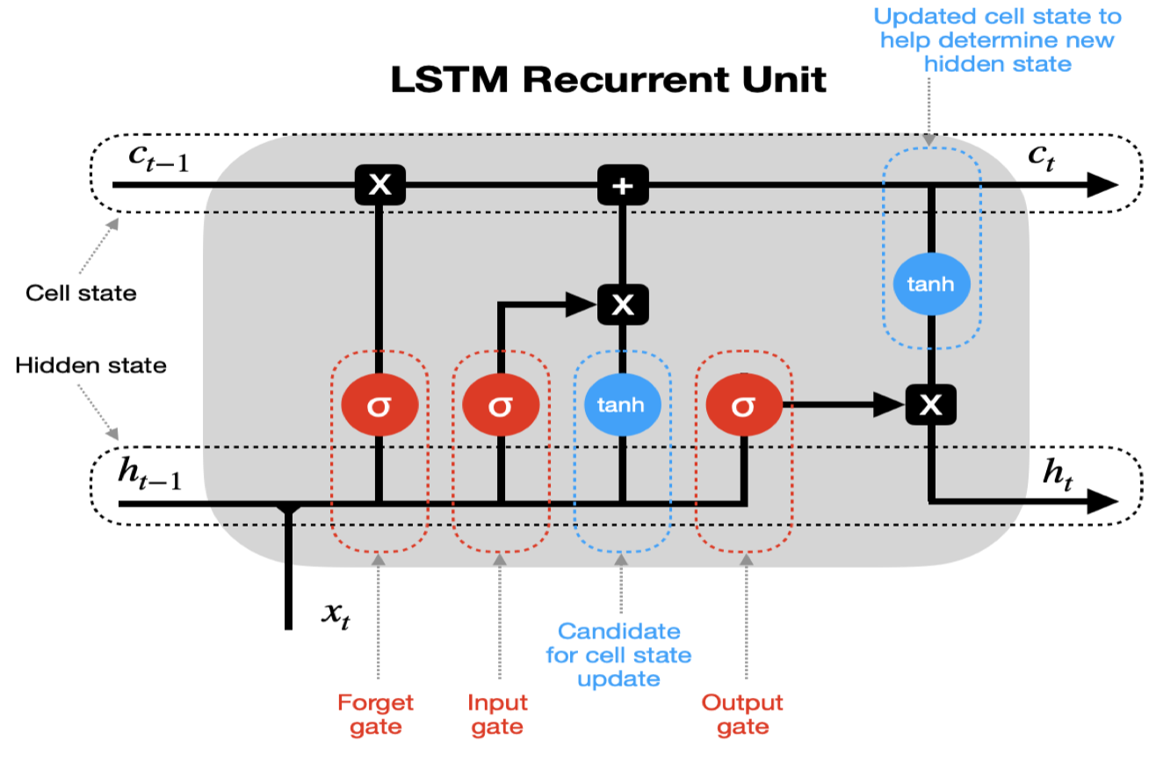
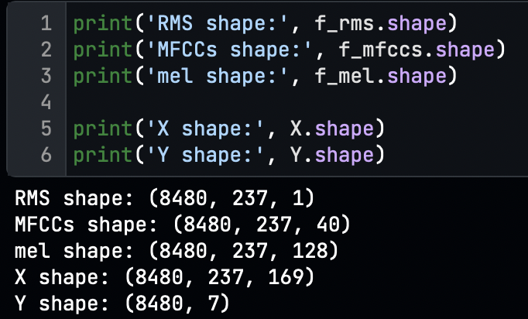
Model Training and Evaluating
We split the dataset into train and validation sets with the ratio of 80/20 using the train_test_split function of the Sklearn library.
For this problem, we have selected the Long Short-Term Memory (LSTM) algorithm to build the neural network.
LSTM is a sub-category of RNN (Recurrent Neural Network), which can be able to decide which information is kept or which information should be deleted

Slide 20
Building Neural Network
We have trained two models.
Emotion Classifier (Multiclass Classification Problem)
Used Adam Optimizer
ReLU Activation Hidden layer
Softmax activation function
Batch size 256
Epochs 160
Gender Classifier (Binary Classification Problem)
Used Adam Optimizer
ReLU Activation Hidden layer
Sigmoid activation function
Batch size 256
Epochs 60

Slide 21
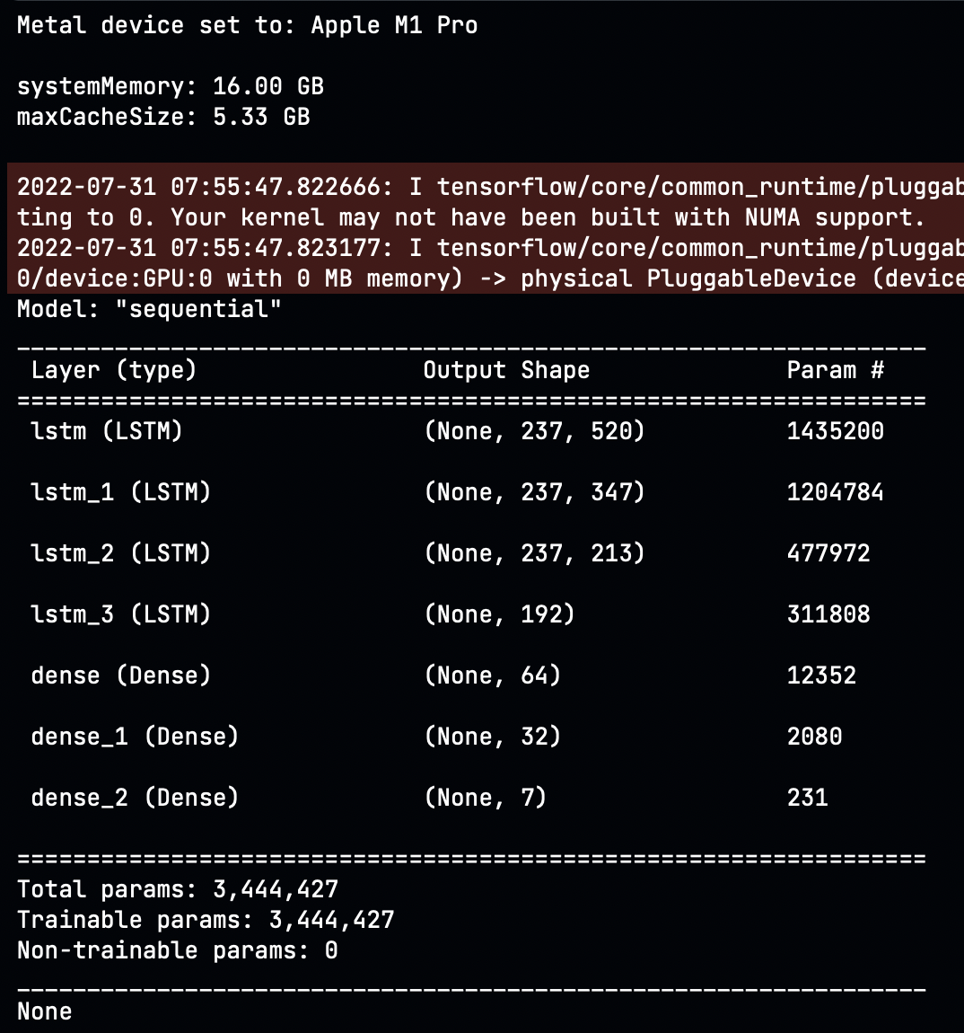
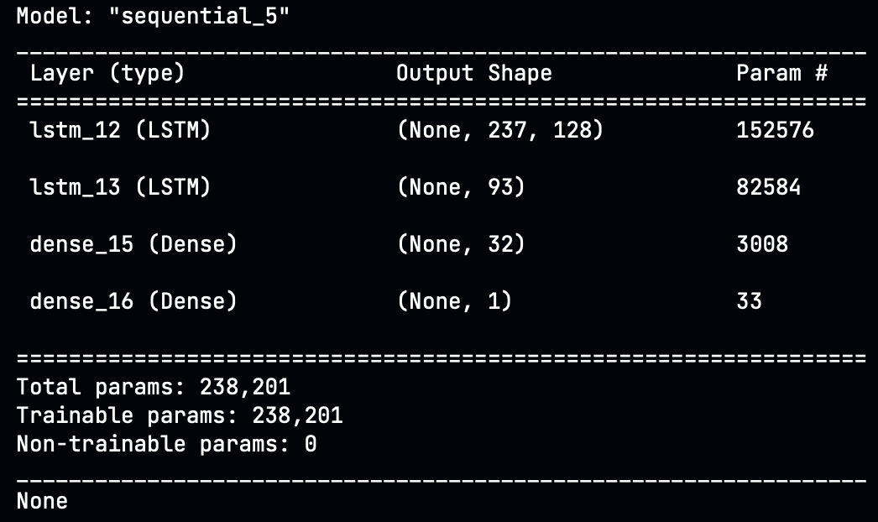
Model Architecture

Slide 22
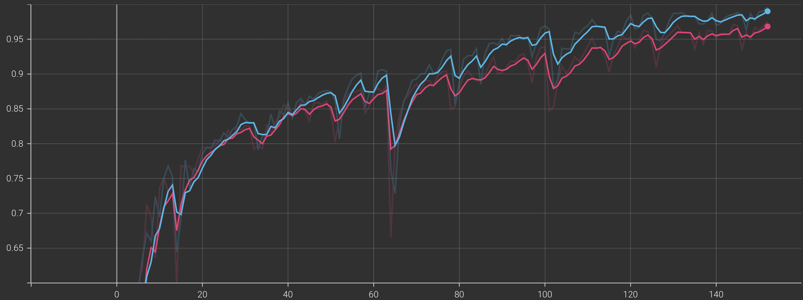
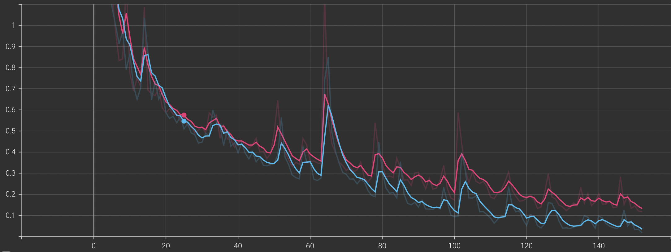
Emotion Classifier
Train-Test Accuracy and Loss graph of Emotion classifier.
We have achieved the categorical training accuracy of 0.9906 with a loss of 0.035 and the validation accuracy of 0.9684 with a loss of 0.1184.

Slide 23
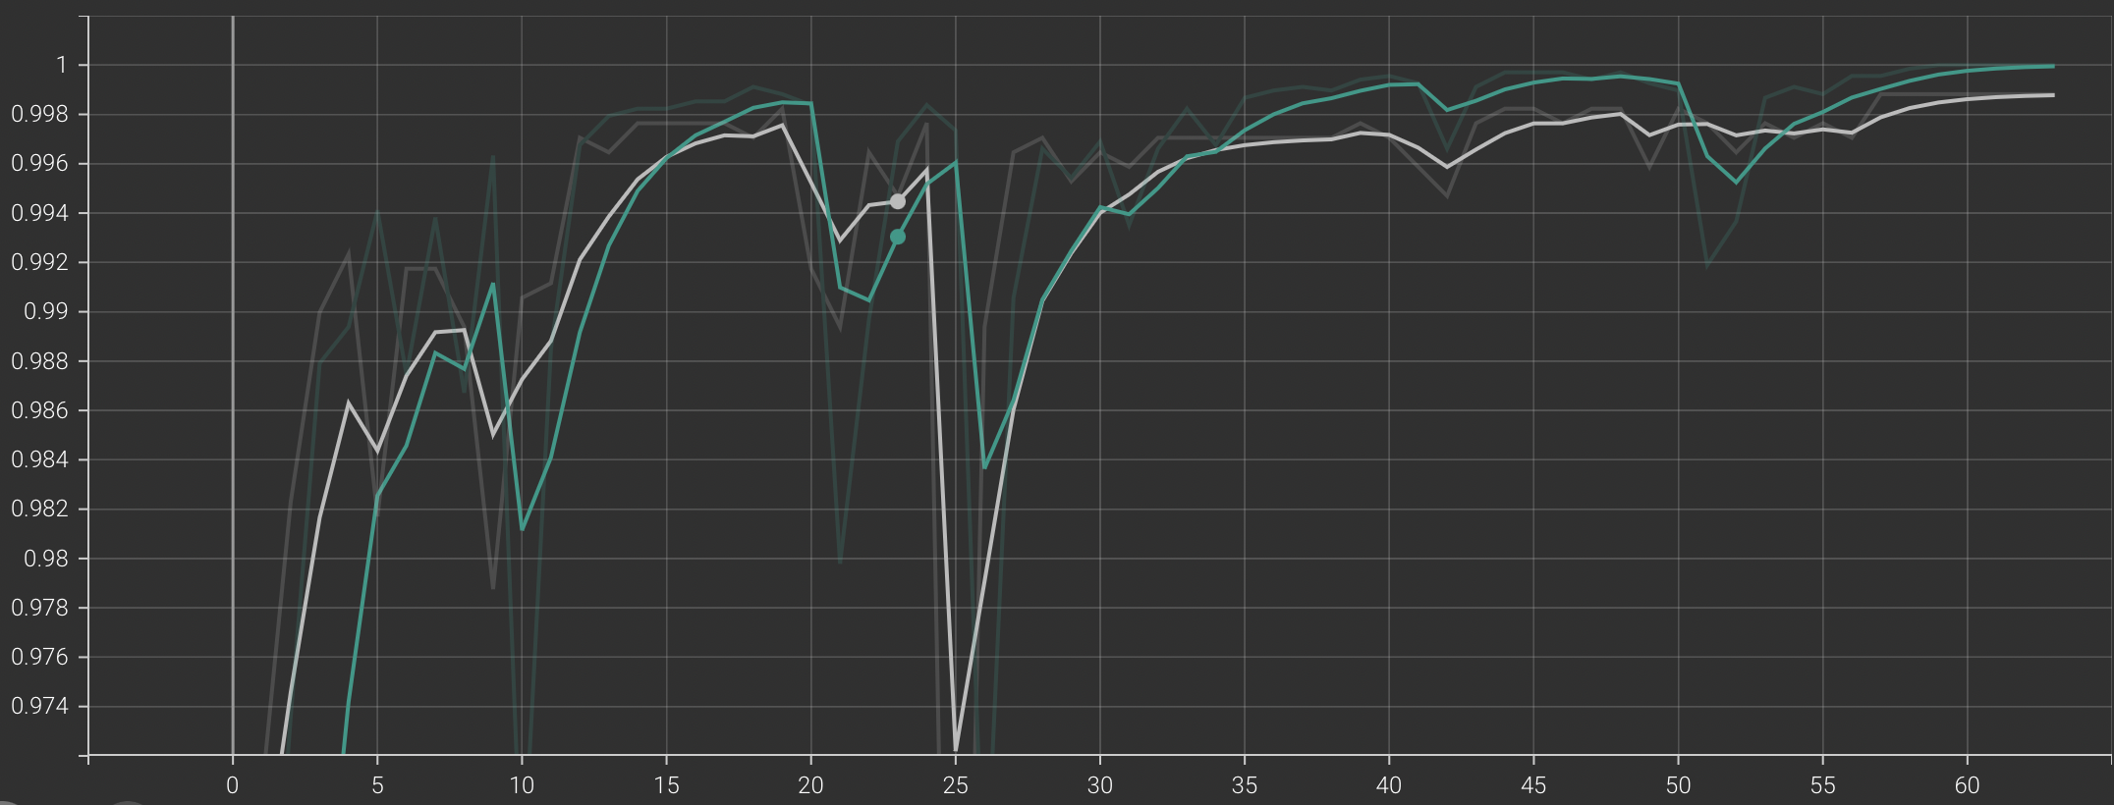
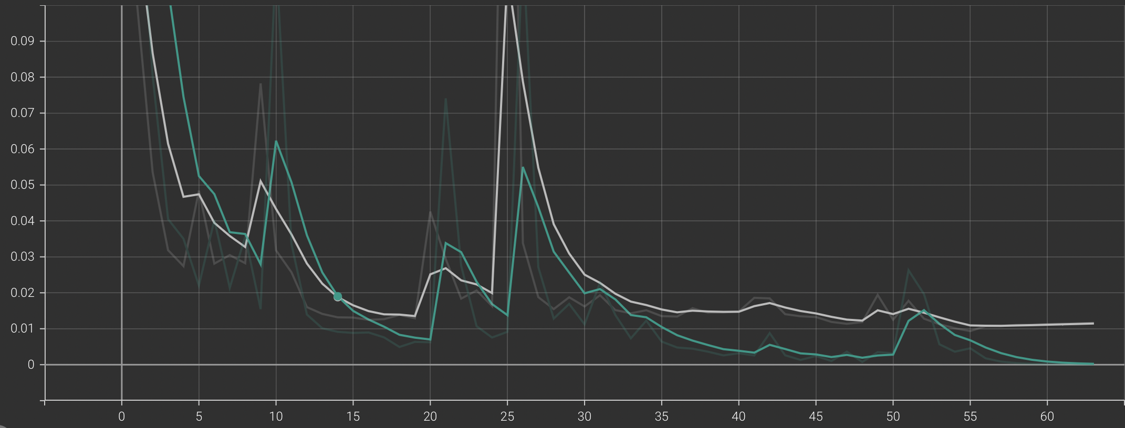
Gender Classifier
Train-Test Accuracy and Loss graph of gender classifier.
The gender classifier is 99% accurate on the validation data, with a loss of 0.011.

Slide 24
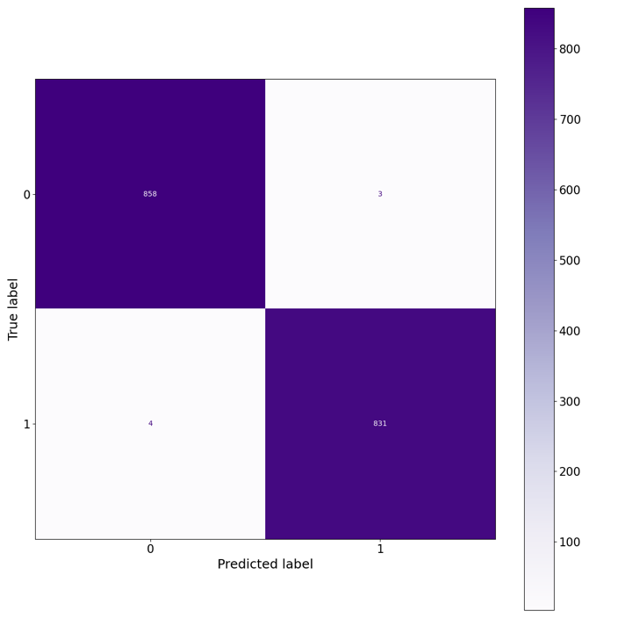
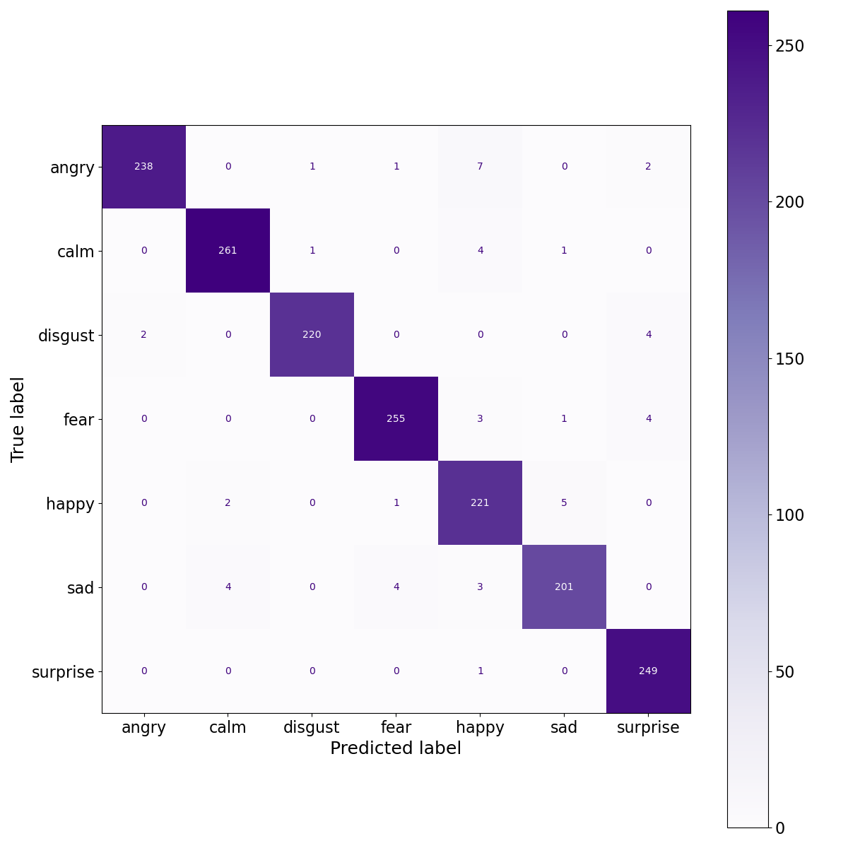
Confusion Matrix for Emotion and Gender Classifiers

Slide 25
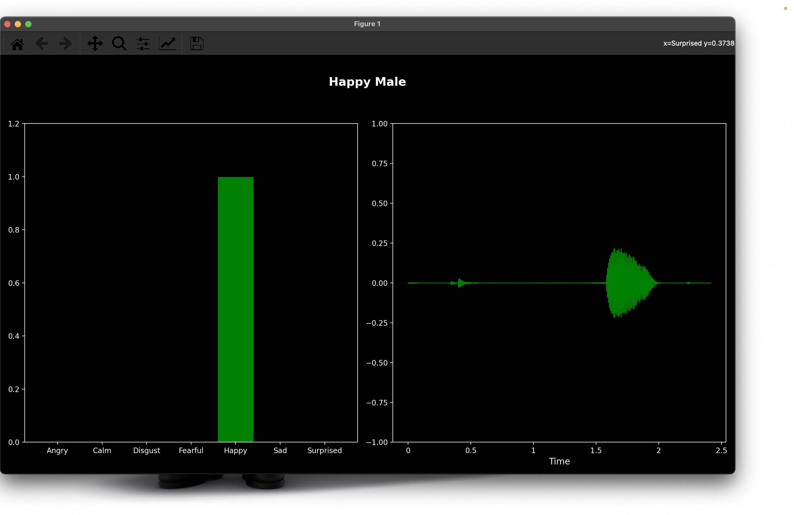
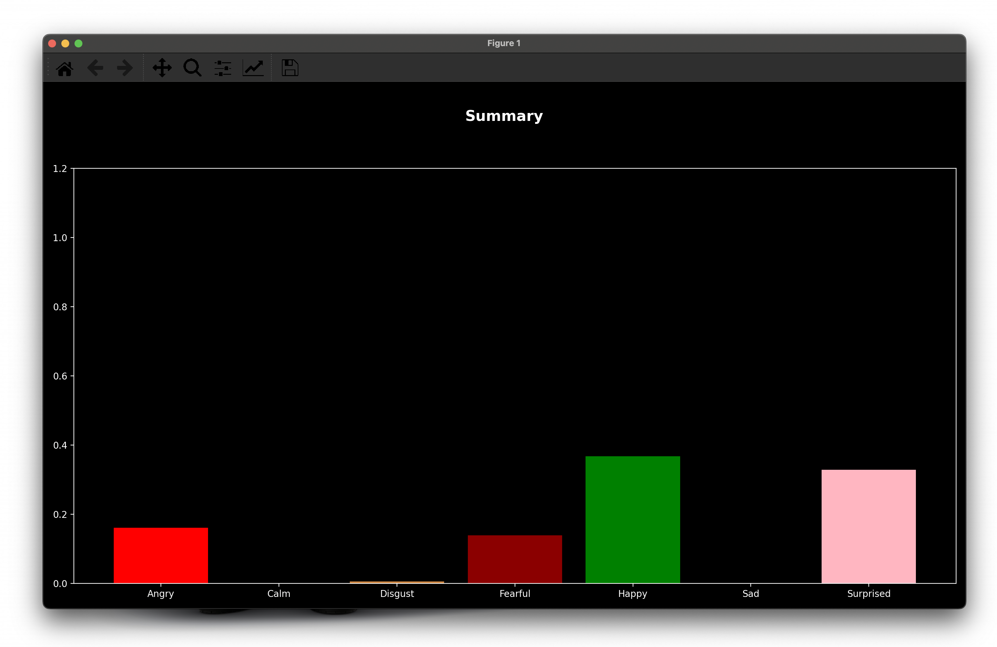
Final Result

Slide 26
Thank You 🙂

